Slide 1





Pie & AI: Anand
Introduction to Deep Learning and
Neural Style Transfer
Speakers:
Rakshil Kevadiya
ML Team
Jay Kshirsagar
ML Team

Slide 2

Let’s recollect what is DL from the previous workshop!
Deep Learning is subset of Machine Learning which does not require feature engineering/extraction and can learn patterns from data with sparse pre-processing.
But unlike Classical machine learning algorithms, Deep learning algorithms requires a lot of data(usually at least 10 times more) of the pattern it is trying to find. It also requires a lot of computing power compared to classical machine learning algorithms.
The current development in data collection and hardware acceleration has given us access to huge amounts of different types of data and high speed computation which allows us to practically implement deep learning algorithms.

Slide 3

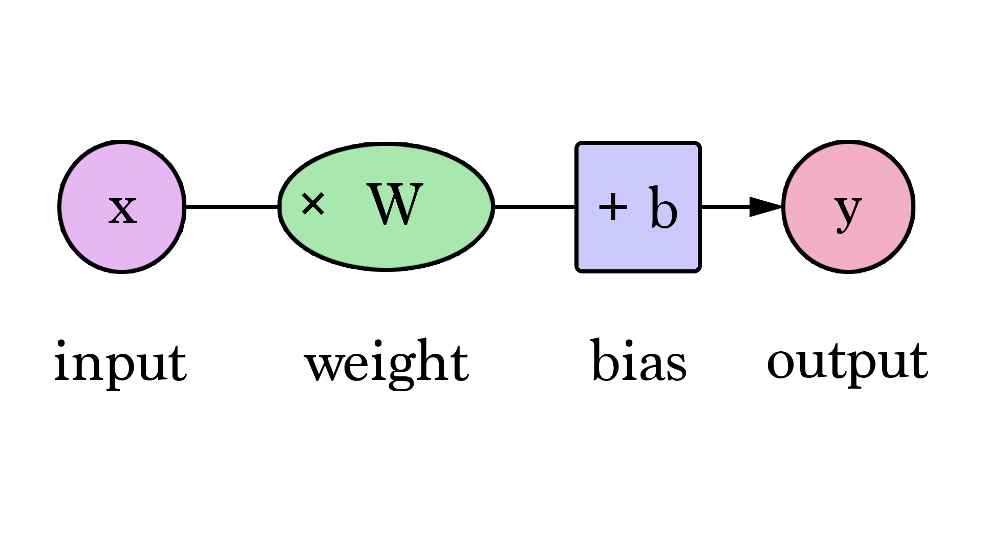
Building blocks of a Neural Network.
Inputs
Hidden layer - weight & biases / activation functions
Output

Slide 4

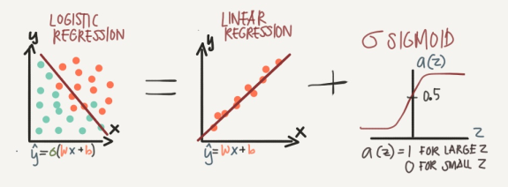
Logistic Regression
Logistic Regression = Linear regression + activation function.(σ)
Used when required output is categorical.
Activation function: an activation function is a function that is added into an artificial neural network in order to help the network learn complex patterns in the data.
Sigmoid Function

Slide 5
Basic Neuron
Smallest unit of all DL algorithms: Neuron(Perceptron). Y(Output) = Σ(Weight * input) + bias
Weights control the signal (or the strength of the connection) between two neurons. In other words, a weight decides how much influence the input will have on the output.
Biases, which are constant, are an additional input into the next layer. Bias in ML does help us generalize better and make our model less sensitive to some single data point.

Slide 6
Other important terms
Training set: Part of dataset used for model training.
Testing set: Part of dataset used for model testing.
Loss function: loss function mainly applies for a single training.
Cost function: the cost function which deals with a penalty for a number of training sets or the complete batch.

Slide 7
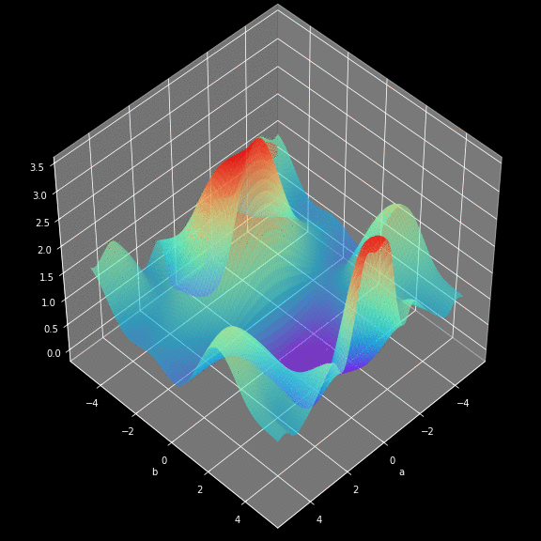
Gradient descent
Gradient descent is an optimization algorithm used to find the values of parameters (coefficients) of a function (f) that minimizes a cost function (cost).
Many more optimizers:
Gradient descent with momentum
Mini batch gradient descent
RMSprop
Adam
Learning rate decay

Slide 8
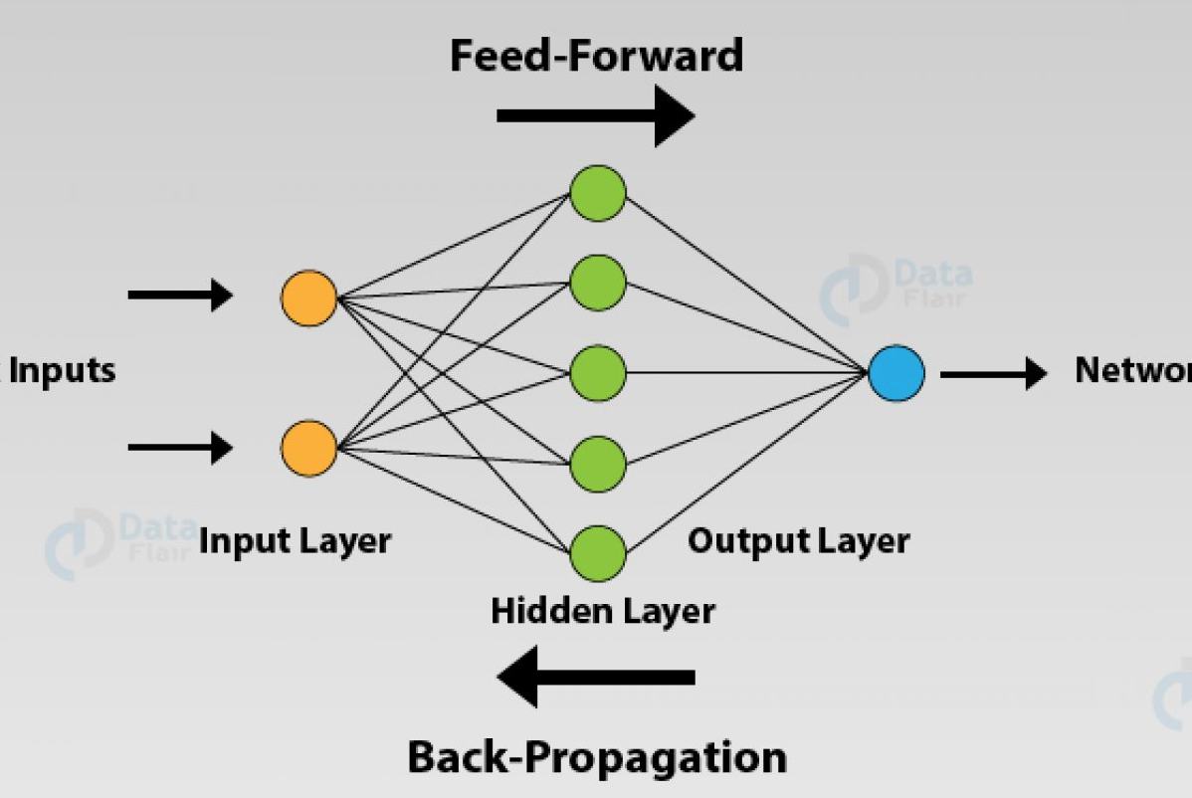
Putting it all together!
Combining every previous concept we get a mini neural net which is ANN.
Activation (Sigmoid)
Forward prop.
Backward Prop.
Gradient descent + update W and B.
Repeat until converges.

Slide 9
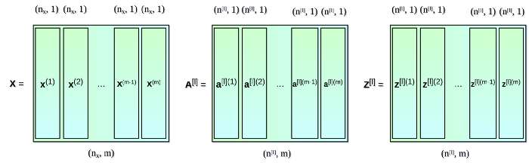
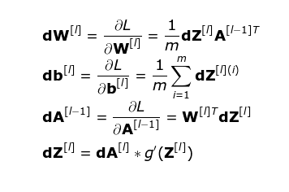
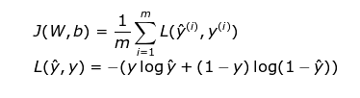
Maths is everywhere!
Vectors, Metrices, Calculus, Probability, statistics etc.

Slide 10
Convolution Neural Net Fundamentals
Key element: Filter/Kernel/Convolution (*)
A matrix which we convolve on an input to get edges/depth etc.
Why CNN for images?
Array of pixels: very huge data
The role of the CNNs is to reduce the images into a form which is easier to process, without losing features which are critical for getting a good prediction.

Slide 11

Intuition

Slide 12

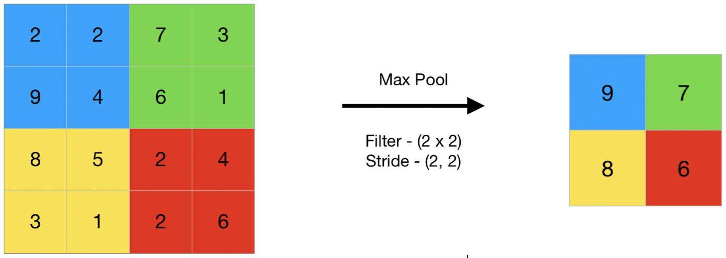

Let’s learn CNN with an architecture (VGG)
Channels: greyscale, RGB, CMYK.
Max pooling:
Softmax: The softmax function is used as the activation function in the output layer of neural network models that predict a multinomial probability distribution.

Slide 13
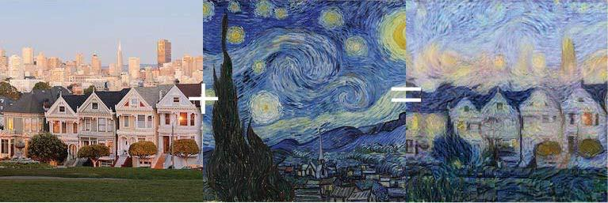
Neural Style Transfer
Content + Style = Generated

Slide 14
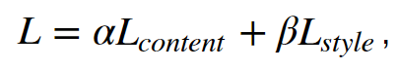
NST Basics
NST employs a pre trained convolution neural network (CNN) to transfer styles from a given image to another. This is done by defining a loss function that tries to minimise the differences between a content image, a style image and a generated image
Content Loss: The content loss function ensures that the activations of the higher layers are similar between the content image and the generated image.
Style Loss: The style loss function makes sure that the correlation of activations in all the layers are similar between the style image and the generated image.
Gram Matrix: The Gram matrix essentially captures the “distribution of features” of a set of feature maps in a given layer. By trying to minimise the style loss between two images, you are essentially matching the distribution of features between the two images

Slide 15
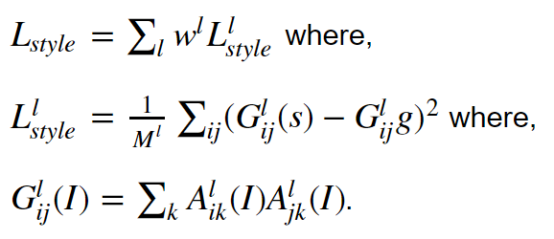
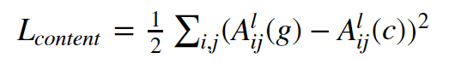
Mathematical equation of loss functions

Slide 16


Thank You!

